Slide 2
Designing ASP.NET MVC 5 Web Applications
Planning in the Project Design Phase Designing Models, Controllers, and Views
Notes:
20486A
02: Designing ASP.NET MVC 4 Web Applications

Slide 3
Plan Database Design
Logical Modeling
Physical Database Structure
Working with DBAs
Database Design in Agile and Extreme Programming
Notes:
The audience of this course has experience in creating databases for simple web applications. The database objects that you describe should refresh their memory or fill in gaps in their knowledge. However, a complete description of all the objects in Microsoft SQL Server 2012 or other database engines is beyond the scope of this ASP.NET course and you cannot train the students to be DBAs. The intention is to provide a simple introduction to database structures.
Question: You want to implement a shopping cart on your web application. How many logical data models are required? How many database tables are required?
Answer: Answers may vary. Logical models may include a Shopping Cart, a Customer, a Product, and a Shipping Method. Students might suggest others. Database tables may include ShoppingCarts, ShoppingCartEntries, Products, ShippingMethods, Customers and others.
20486A
02: Designing ASP.NET MVC 4 Web Applications

Slide 4



Planning for Distributed Applications
Layers
Presentation
Business Logic
Data Access
Database
Communication
Security
Browser
Web
Server
Presentation
Middle
Tier
Server
Business Logic
Data Access
Database
Server
Notes:
The subject of distributed applications, their architecture, and the protocols and technologies underlying them is huge and cannot be treated in full here. Your aim should be to introduce the concepts and technologies like WCF. If students demonstrate an interest in building distributed architectures for their web application, refer them to Course 20487A: Developing Windows Azure and Web Services.
Question: What are the advantages of writing middle tier components as WCF services and not web services?
Answer: You can host WCF services on either Internet Information Server (IIS) or WAS. Web services can only be hosted on IIS.
20486A
02: Designing ASP.NET MVC 4 Web Applications

Slide 5
Planning State Management
Client-side locations to store state data:
Cookies
Query Strings
Server-side locations to store state data:
TempData
Application State
Session State
Profile Properties
Database Tables
Notes:
In Module 4, you will describe to the students the ViewBag and ViewData objects. Do not introduce them here because the ViewBag object and ViewData object cannot be used to store state information. They are destroyed for a new page request. Those objects are used to store information between the controller, view, and partial views that render a single HTML page.
You might like to present some state management scenarios from your own experience of building real-world MVC web application and discuss with the students the most appropriate location to use.
If you have any ASP.NET Web Forms developers in the class, emphasize that View State, Control State, and Hidden Fields are not available. You should discourage them from developing similar solutions for MVC pages because of the extra resources such approaches use to store data in HTML pages.
Question: You show the visitors of your website a choice of countries. When they pick a state, you want to redirect them to a page that shows a map of that state. You will not use the name of the chosen country that the user selected after this. Which location should you use to store the name of the chosen country?
Answer: The TempData store is ideal for storing the country because you only use it on the next page. Alternatively you could use a query string value or a form field with the POST method to pass the country value.
20486A
02: Designing ASP.NET MVC 4 Web Applications

Slide 6
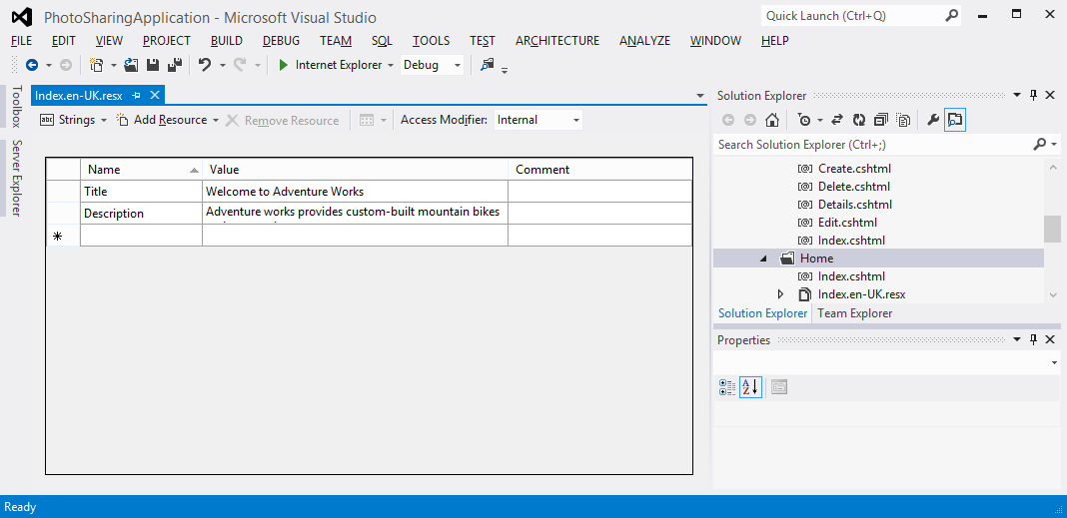
Planning Globalization and Localization
You can use the internationally-recognized set of language codes available in browsers to present content customized to suit a user’s language or region
You can use resource files to provide a localized response suitable to a user’s culture
You can use separate views to suit each language code
Notes:
Which language do you consider would be appropriate to specify in the default resource file?
The language that you choose for the default resource file should be the one that is spoken by the largest proportion of your visitors. As Internet is a global system, this is usually English because it is the language spoken by the largest number of people, worldwide.
20486A
02: Designing ASP.NET MVC 4 Web Applications

Slide 7
Discussion: Working on a Design Scenario1
For the Northwind Traders Scenario discuss:
Domain Model Objects
Database Tables
Server Numbers and Layered Architecture
State Management
Notes:
The scenario presented is simple. It is not necessarily possible to precisely determine all the aspects of the design and provide a single correct answer for your students. Instead, use this topic to promote discussions and get students to think about design as they would in a real-world situation.
The following suggestions support the scenario as it is described. However, you may have an alternative design and your students may also suggest helpful ideas. Use these suggestions only as a starting point:
Domain Model Objects:
Product
User Account (one for each Retailer)
Shopping Cart
Retailer (to store information about outlets)
Database Tables:
Products
User Accounts
Retailers
Shopping Carts
Shopping Cart Entries
Architecture:
Because this is a business-to-business site, large numbers of concurrent users are unlikely. A single set of servers that hosts all layers should suffice.
The site is business-critical, so you should ensure that server-failures do not render the site unavailable. Use two or more servers in your farm, or deploy to Windows Azure.
State Management
20486A
02: Designing ASP.NET MVC 4 Web Applications
(More notes on the next slide)

Slide 8
Designing Models
Model Classes and Properties
Domain Model and Logical Data Model Diagrams
Relationships and Aggregates
Entity Framework
Design in Agile and Extreme Programming
Notes:
20486A
02: Designing ASP.NET MVC 4 Web Applications

Slide 9
Designing Controllers
Controller | Action
Photo | AddPhoto (GET)
 | AddPhoto (POST)
 | DisplayGallery (GET)
User | Logon (GET)
 | Logon (POST)
Identify Controllers and Actions
Design in Agile and Extreme Programming
Notes:
20486A
02: Designing ASP.NET MVC 4 Web Applications

Slide 10
Designing Views
Views, Templates, and Partial Views
Wire-Framing
Design in Agile and Extreme-Programming
Notes:
The graphic on the slide is a simple wire-frame diagram that resembles the photo details view in the photo sharing application that the students will build in the labs.
20486A
02: Designing ASP.NET MVC 4 Web Applications

